Slide 1
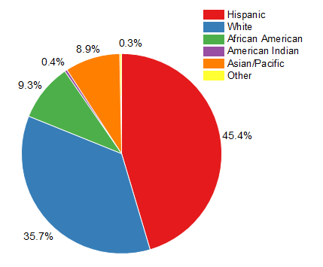











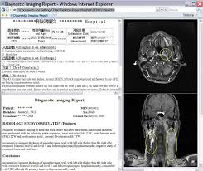



Data System Architecture Design – Streaming Data
Data Source
Data Integration and Cleansing Raw Data
Data Ingestion / Data Storage
Data Analytics
1
2
4
8
Raw Data
5
6
3
Data Cleansing / Data Processing
Incremental un-structured Data import.
7
Consuming Data
9
1
Raw data Retrieve from online website (REST API).
5
AVRO file ingested to Hive Database.
Nifi Scheduling Job and Kafka message queuing. Publish Kafka Processor sends JSON file to Spark Application.
6
Data stored HBase (NoSQL DB).
2
7
Data retrieve from Hive table using Java API
3
Raw data JSON format
Data Analytics (Dashboard).
8
4
Cloudera – Spark cleanse raw data and convert the AVRO format file (AVSC – Incremental Un-Structured data import).
9
Consuming data from Java API.

